Slide 1

Ensemble of deep learning models for eye disease classification
Group ID: 07
Tasnia Haque Kheya (Id: 0424052084)
Shaikh Prothomaa Binte Minhaz (Id: 0424052087)
Md. Mahadi Hasan Ankon (Id: 0424058012)

Slide 2
Outline
Introduction
Problem statement
Project novelty
Methodology
Initial experiment results
Remaining experiments
Conclusion

Slide 3
Introduction
Implementation of advanced deep learning models to classify eye diseases based on computer vision techniques
Ensemble of deep learning models using bagging and voting for better performance
This approach can perform multi-disease classification

Slide 4
Problem statement
Eye diseases like diabetic retinopathy, glaucoma, and age-related macular degeneration causes blindness which can be detected by classification models of deep learning
Single model struggle with accuracy due to image variability, class imbalance and difficulties in handling multi-disease diagnosis
An ensemble of deep learning models can solve these issues by combining the strengths of multiple models, improving accuracy, robustness, and reliability for better eye disease classification

Slide 5
Project novelty
Dataset
This study focuses on a dataset specially representing Bangladeshi ethnicity.
It addresses a significant gap, as Bangladeshi ethnicity has not been represented in prior studies.

Slide 6
Project novelty
A Comprehensive Preprocessing pipeline for enhanced Image Analysis:
Sharpening Edges, Adjusting Lighting, CLAHE, Gaussian Blur and Applying Color Normalization with Noise Reduction for consistency
Augmentation to enhance dataset diversity and resolve class imbalance

Slide 7
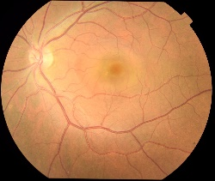
Methodology
Ensemble Architecture
Preprocessing
Xception
mobilenet
Densenet
Resnet 50
Gray Scale
CLAHE
Train-Validation-Test Split
Flatten
LSTM
Flatten
Flatten
Performance Evaluation
Gaussian Blur
Data augmentation
LSTM
Edge Sharpening
Fully Connected Layer
Input
Model Output
Preprocessed Images
Fig-1: Process Analysis

Slide 8
Methodology
Data preprocessing:
Convert to Grayscale & Create Binary Mask
Extract the region of interest
Remove empty borders by threshold-based cropping
Standardize all images to 224X224 resolution
Apply CLAHE to enhance contrast per channel
Gaussian Blur to suppress noise and create smoother textures
Sharpen the image for better feature distinction

Slide 9
Methodology
Data augmentation:
Adjusts image brightness without distorting image quality
Flips the image horizontally with a 50% probability
Flips the image vertically with a 50% probability

Slide 10
Methodology
Architecture:
Pretrained models:
Mobile Net V3, Dense Net, ResNet101: Leveraged as backbone models for feature extraction.
Each model processes the images to generate deep feature representations.

Slide 11
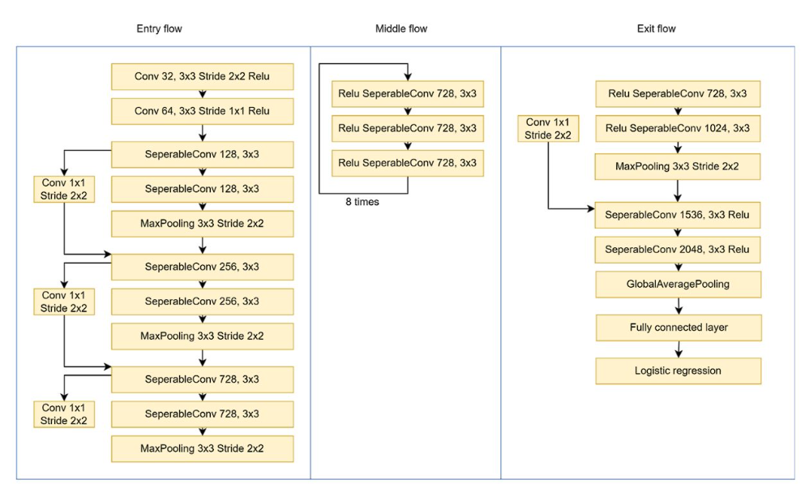
Pretrained models
Xception
Test Accuracy: 73.54%
Test Precision: 0.7541
Test Recall: 0.7354
Test F1 Score: 0.7390
Efficient for feature extraction
Combines depth-wise separable convolutions with residual connections

Slide 12
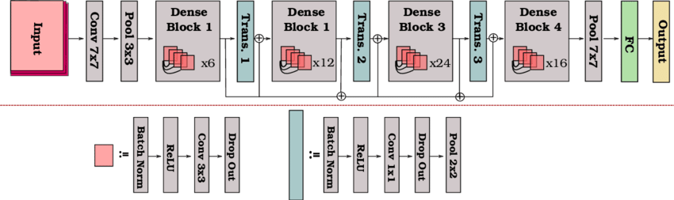
Pretrained models (cont’d)
Dense Net 121
Test Accuracy: 73.33%
Test Precision: 0.7547
Test Recall: 0.7333
Test F1 Score: 0.7413
Uses dense connections to improve information flow and gradient propagation
reducing overfitting

Slide 13
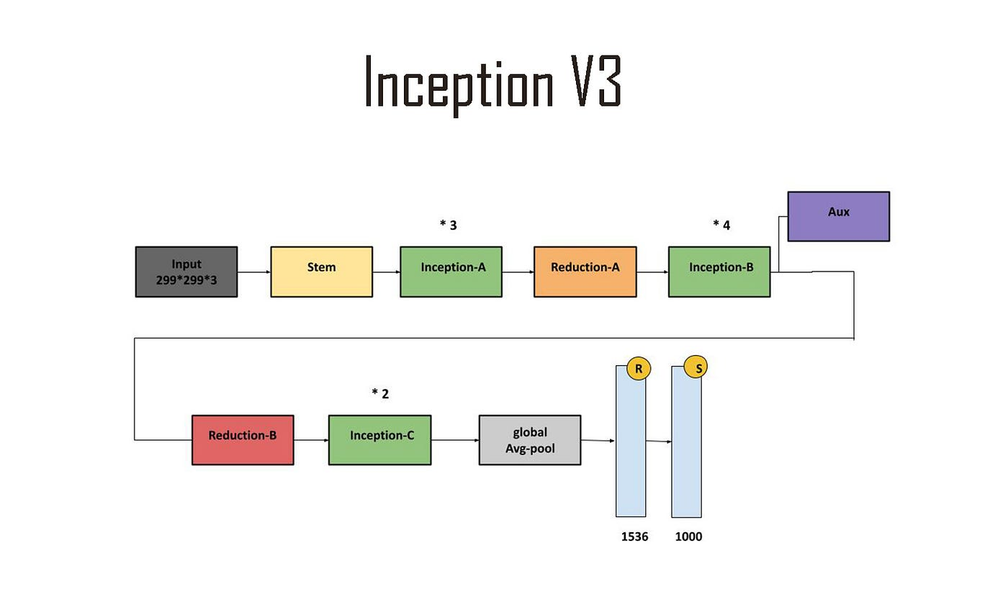
Pretrained models (cont’d)
Inception V3
Test Accuracy: 73.13%
Test Precision: 0.7301
Test Recall: 0.7313
Test F1 Score: 0.7303
Multiple filter sizes in a single convolutional block
Optimizing computational efficiency while maintaining accuracy.

Slide 14
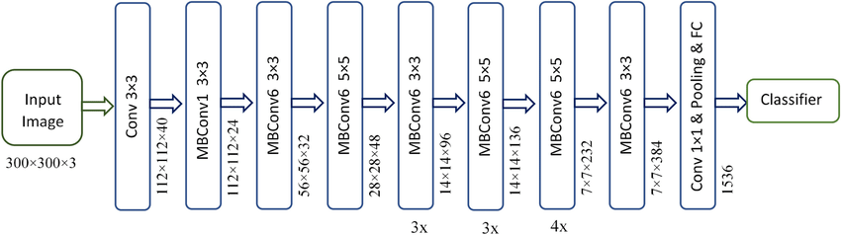
Pretrained models (cont’d)
Efficient B3
Test Accuracy: 73.13%
Test Precision: 0.7473
Test Recall: 0.7313
Test F1 Score: 0.7362

Slide 15
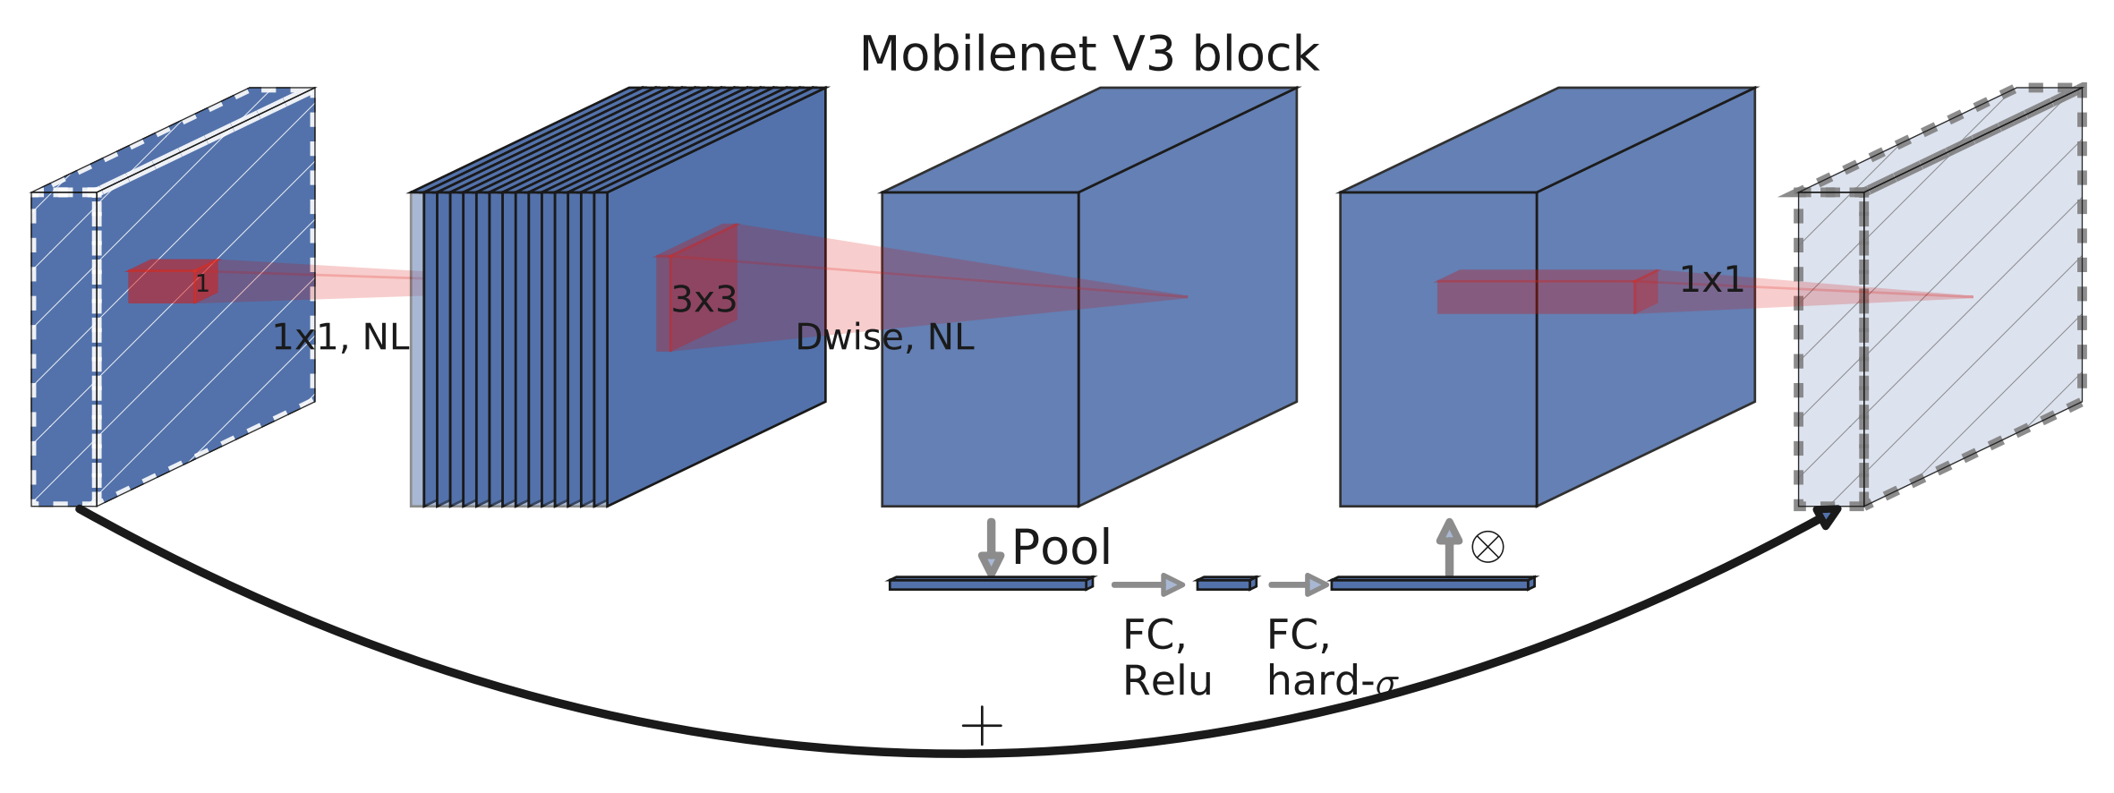
Pretrained models (cont’d)
Mobile Net V3
Test Accuracy: 72.12%
Test Precision: 0.7282
Test Recall: 0.7212
Test F1 Score: 0.7212
Using neural architecture search (NAS) to optimize speed and performance
Designed for mobile devices

Slide 16
Ensemble
Ensemble Layer:
Combines extracted features from different models for ensemble learning.
Xception and Resnet 101: accuracy- 73.74%
DenseNet201 and MobileNetV2 : accuracy-69.09%
Fully connected layers aggregate the features into the final predictions.

Slide 17
Performance
Performance evaluation:
Assesses the model’s effectiveness using metrics
accuracy
precision
Recall
F1-score
Ensures the system's reliability for real-world applications.

Slide 18
Dataset
Dataset analysis
Dataset which was collected during a span of eight months from Anawara Hamida Eye Hospital & B.N.S.B. Zahurul Haque Eye Hospital in Bangladesh using Color Fundus Photography machine[7]
Training on new dataset that helps the model perform better on a wide range of real-world data.

Slide 19
Dataset(Cont.)
Table-1: Table for Classes in Dataset
Serial No. | Class Name in Dataset | No of Images
01. | Central Serous Chorioretinopathy | 101
02. | Diabetic Retinopathy | 1509
03. | Disc Edema | 127
04. | Glaucoma | 1349
05. | Healthy | 1024
06. | Macular Scar | 444
07. | Myopia | 500
08. | Retinal Detachment | 125
09. | Retinitis Pigmentosa | 139

Slide 20
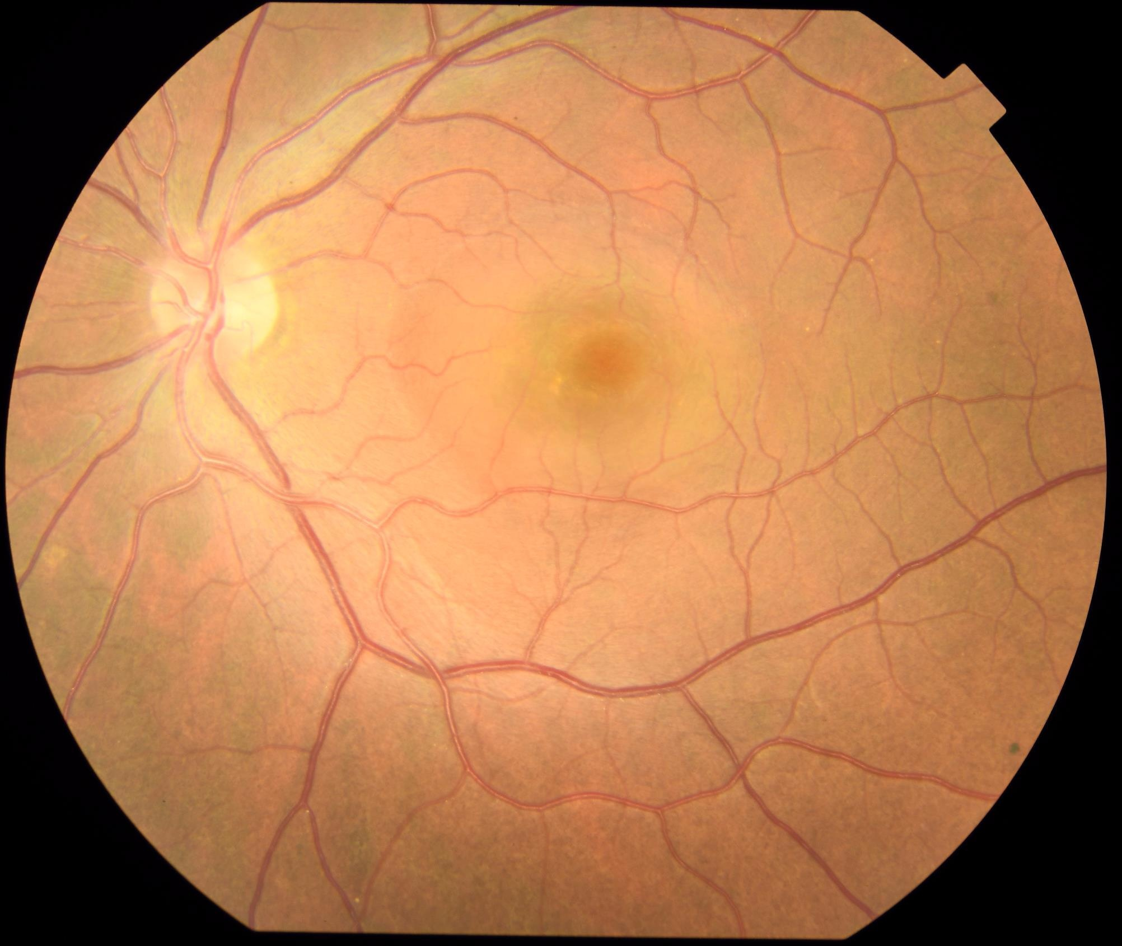
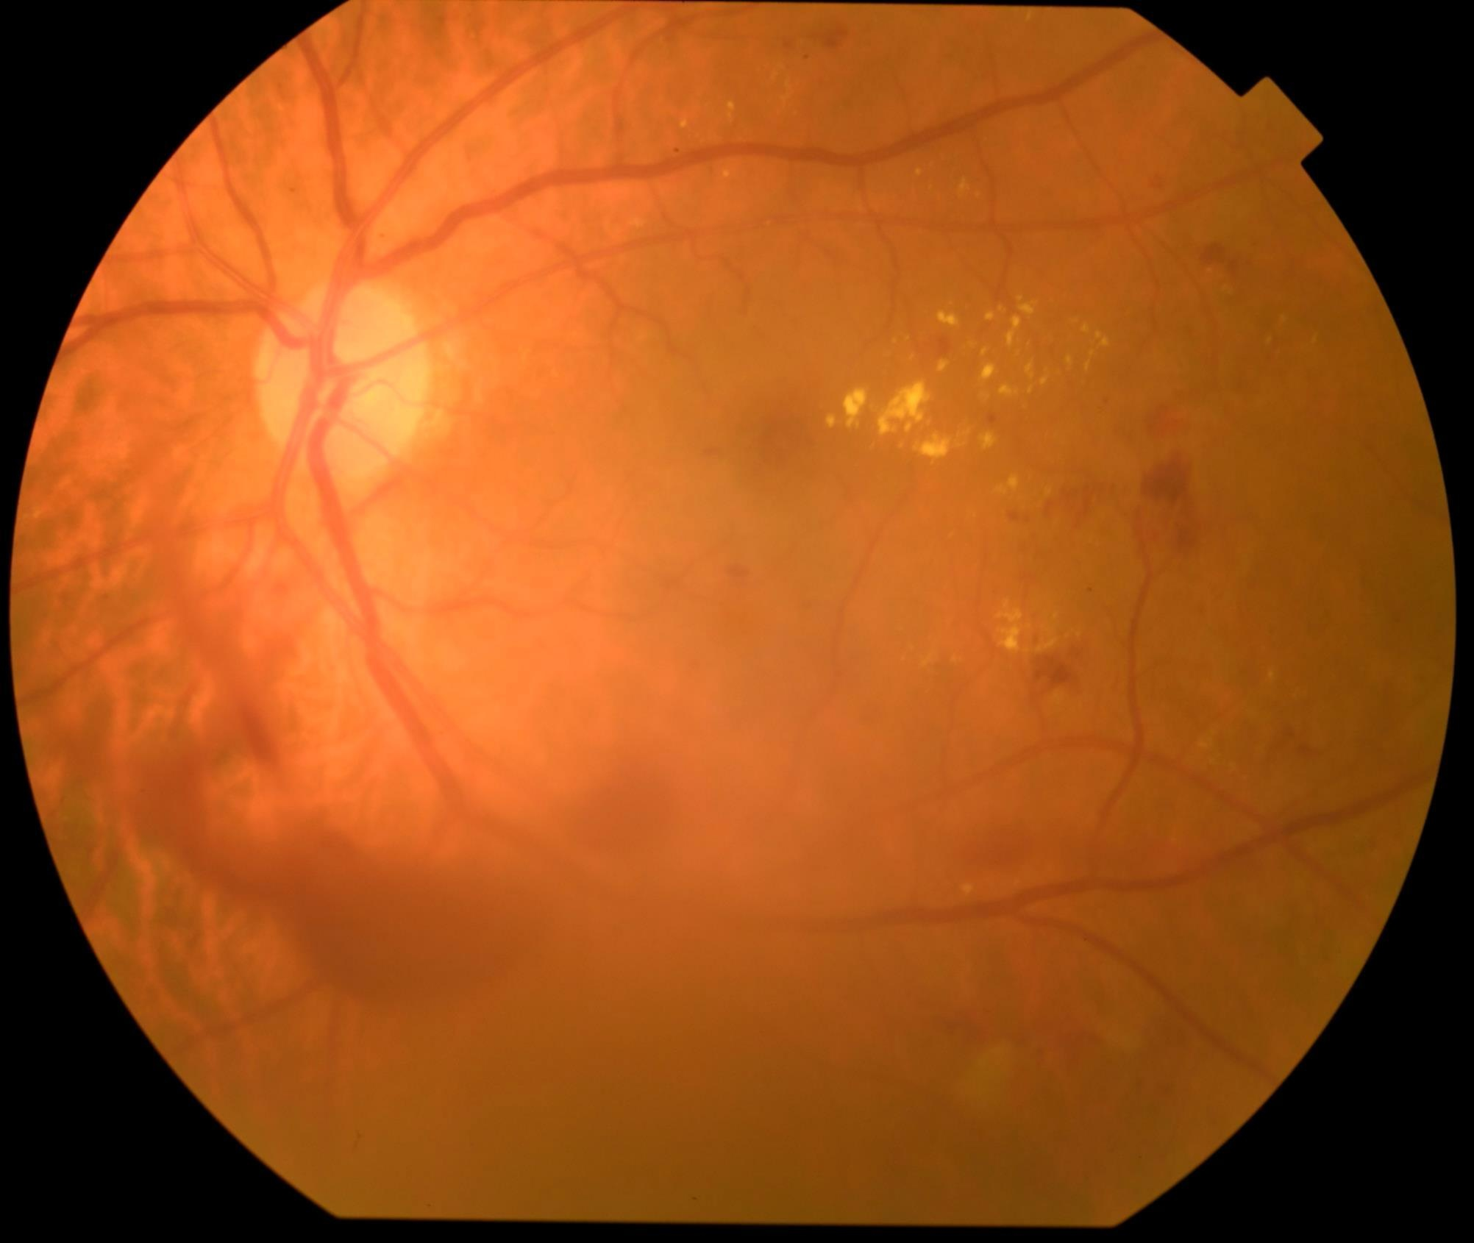
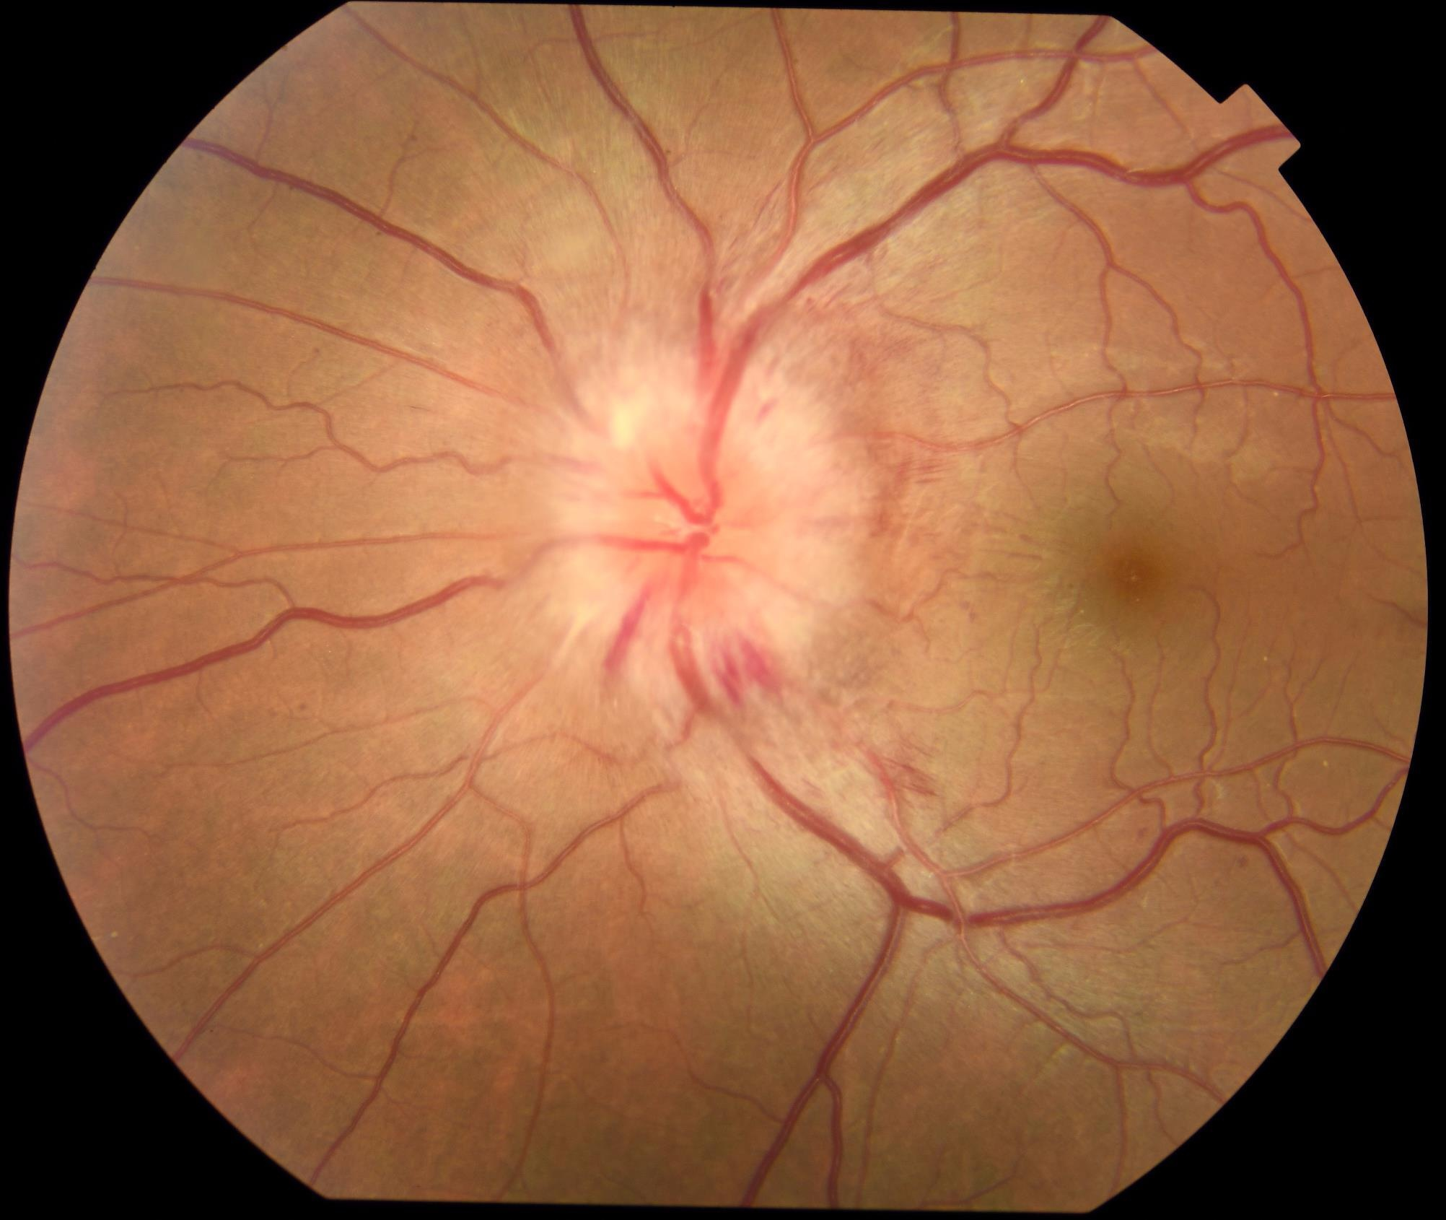
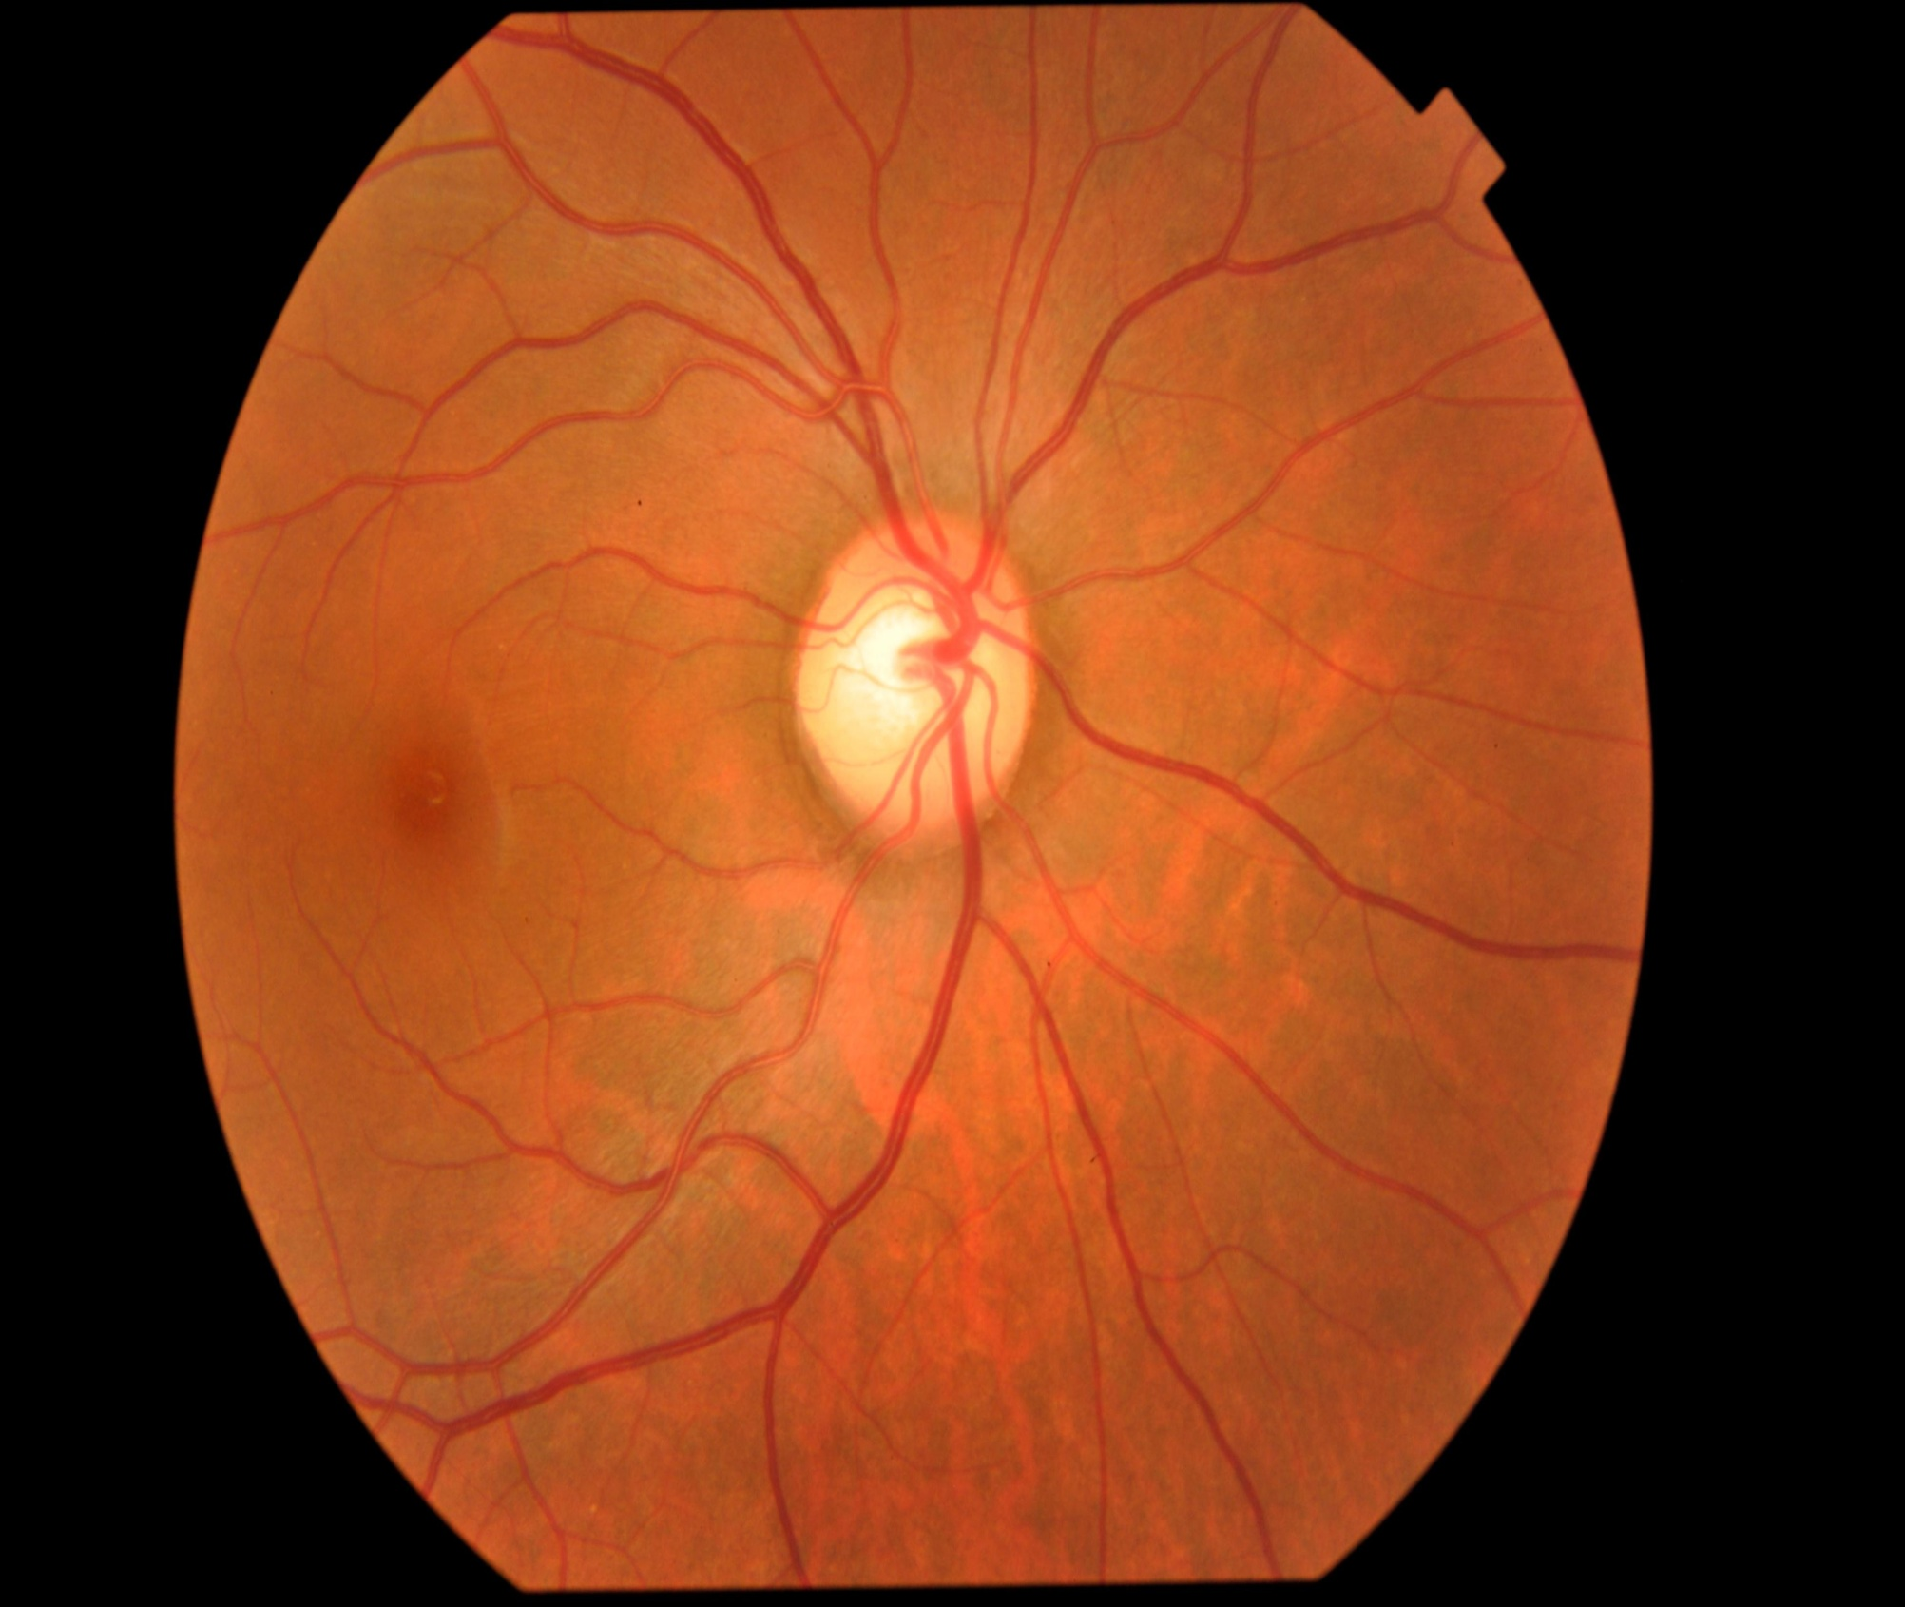
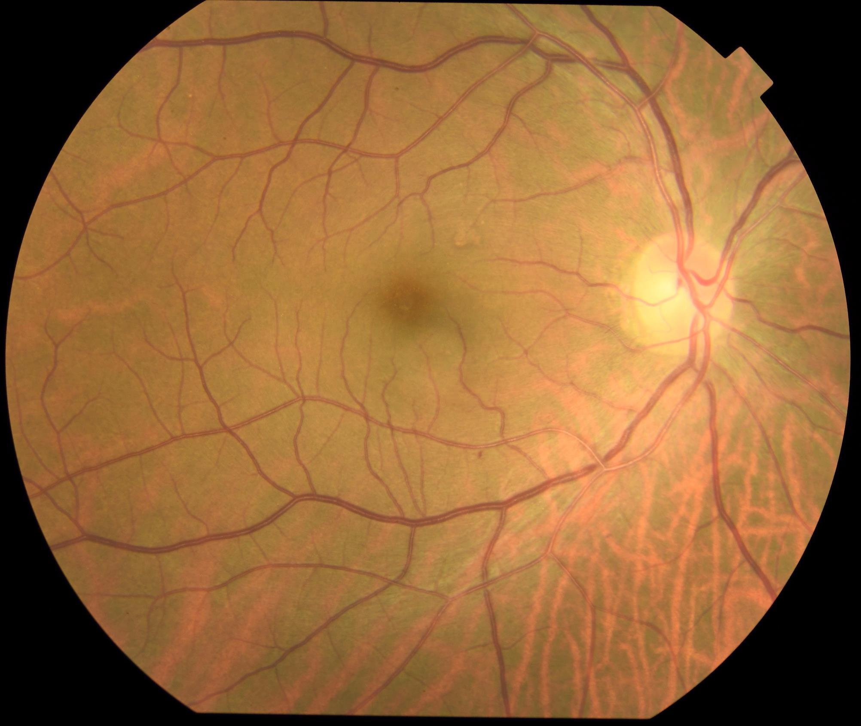
Dataset(Cont.)
(a)
(b)
(c)
(d)
(e)
(f)
(g)
(h)
(i)
Fig2: (a) Central Serous Chorioretinopathy (b) Diabetic Retinopathy (c) Disc Edema (d) Glaucoma (e) Healthy
(f) Macular Scar (g) Myopia (h) Retinal Detachment (i) Retinitis Pigmentosa[7]

Slide 21
Dataset(Preprocessing Steps)
Diabetic
Retinopathy
Glaucoma
Healthy
Macular Scar
Myopia
Original Image
Standardized Bg
Crop Img
Resized Img
CLAHE Applied to RGB channel
Merged CLAHE
Gaussian Blue
Unsharp Masking
Fig 6. Total Preprocessing Steps of Images

Slide 22
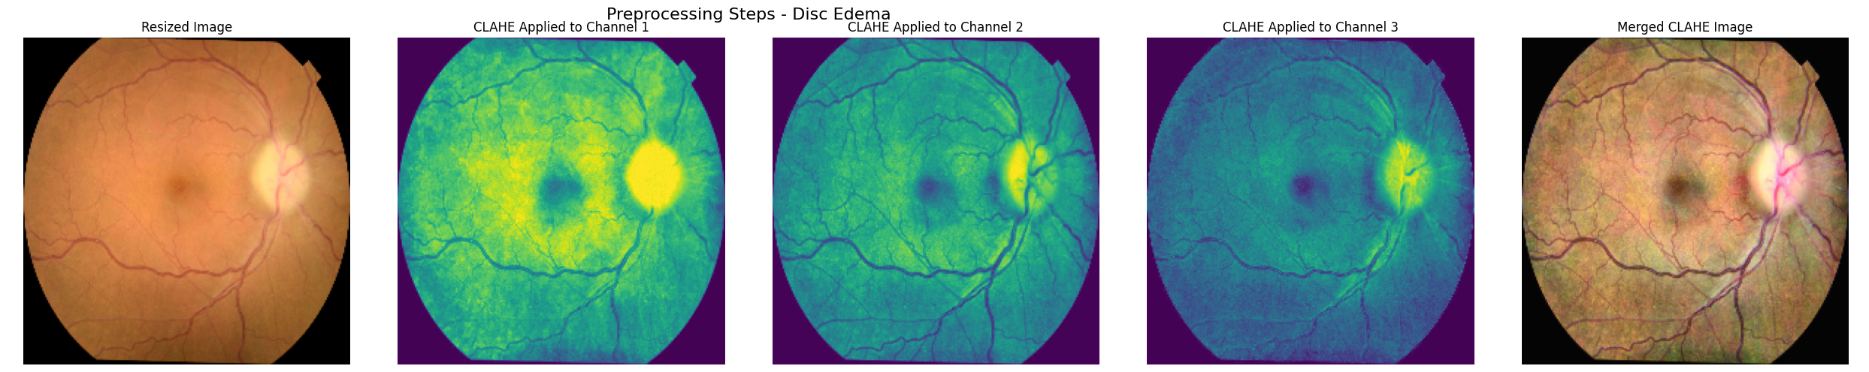
Preprocessing
CLAHE (Contrast Limited Adaptive Histogram Equalization)
Divide image into tiles | Apply clip limit to reduce noise
Redistribute pixel intensities | Stitch tiles for a smooth image
Fig3: Applying CLAHE to the Original Dataset

Slide 23
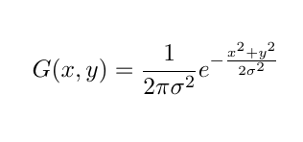
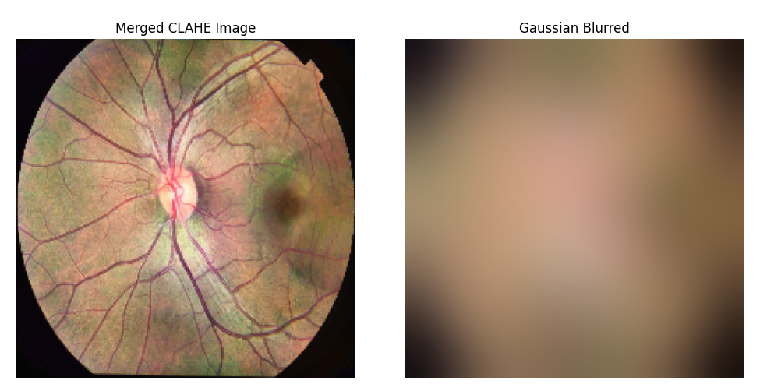
Preprocessing(Cont.)
Gaussian Blur
ttt | Convolution
Create the Gaussian Kernel | Iterative Process
Fig4: Applying Gaussian Blurred to the CLAHE Dataset

Slide 24
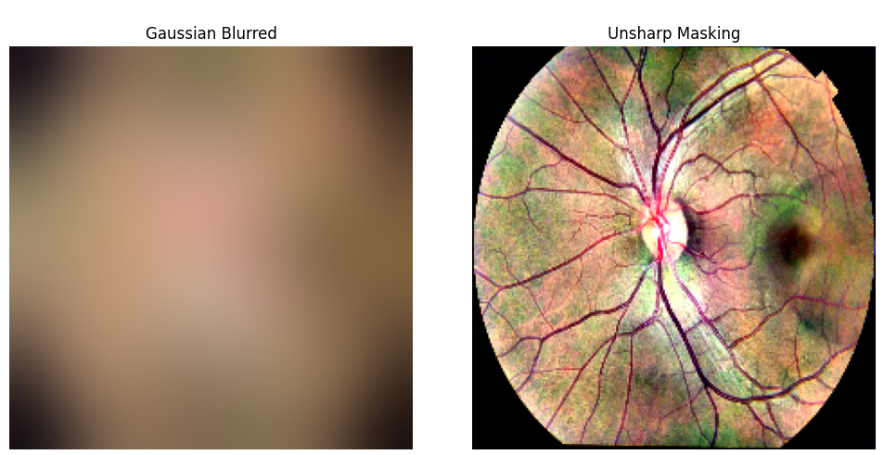
Preprocessing(Cont.)
Unsharp Masking
Subtract the blurred Image from the original image
Resulting image is sharpened with enhanced edges and details.
Fig5: Applying Unsharp Masking to the Gaussian Blurred Dataset

Slide 25
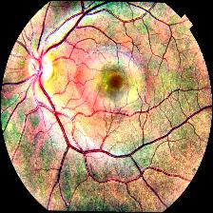
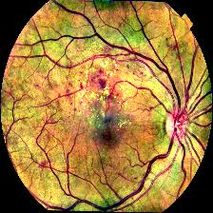
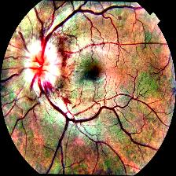
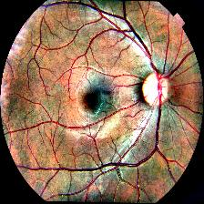
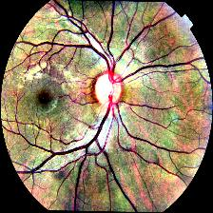
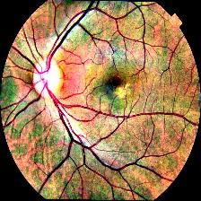
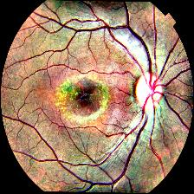
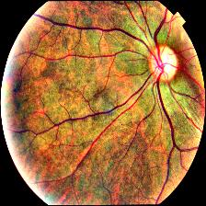
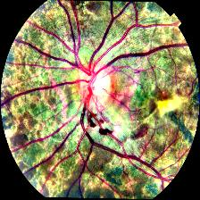
Dataset (After Preprocessing)
(a)
(b)
(c)
(d)
(e)
(f)
(g)
(h)
(i)
Fig7: (a) Central Serous Chorioretinopathy (b) Diabetic Retinopathy (c) Disc Edema (d) Glaucoma (e) Healthy
(f) Macular Scar (g) Myopia (h) Retinal Detachment (i) Retinitis Pigmentosa

Slide 26
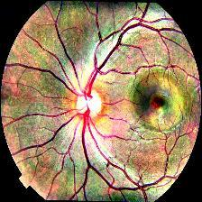
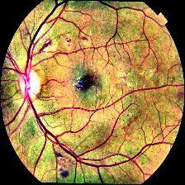
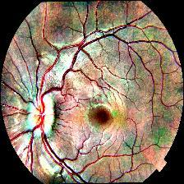
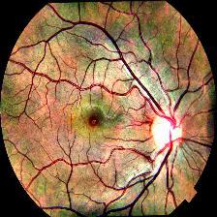
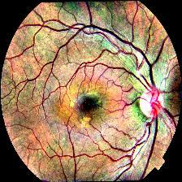
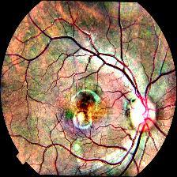
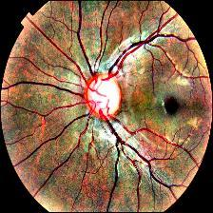
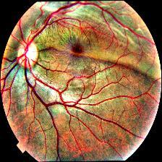
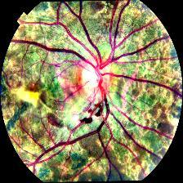
Dataset (After Augmentation)
(a)
(b)
(c)
(d)
(e)
(f)
(g)
(h)
(i)
Fig8: (a) Central Serous Chorioretinopathy (b) Diabetic Retinopathy (c) Disc Edema (d) Glaucoma (e) Healthy
(f) Macular Scar (g) Myopia (h) Retinal Detachment (i) Retinitis Pigmentosa

Slide 27
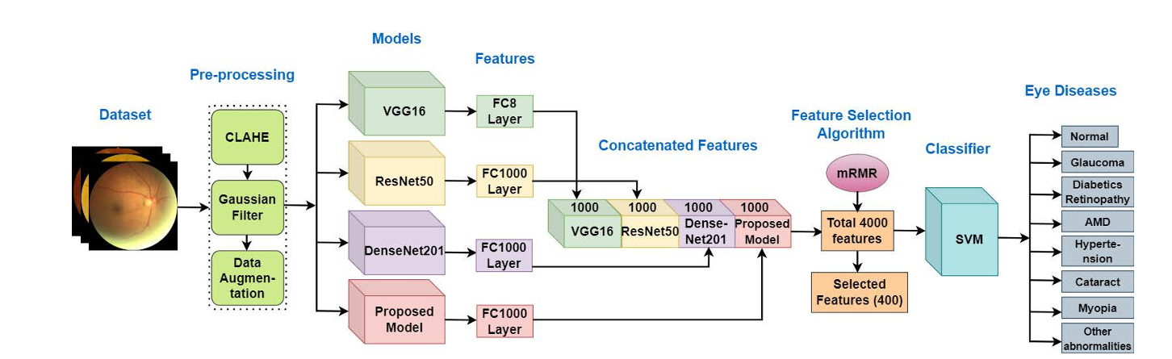
Base Model
Fig 9. Architecture of Deep Neural Network-Based Ensemble Model for Eye Diseases Detection and Classification [9]

Slide 28
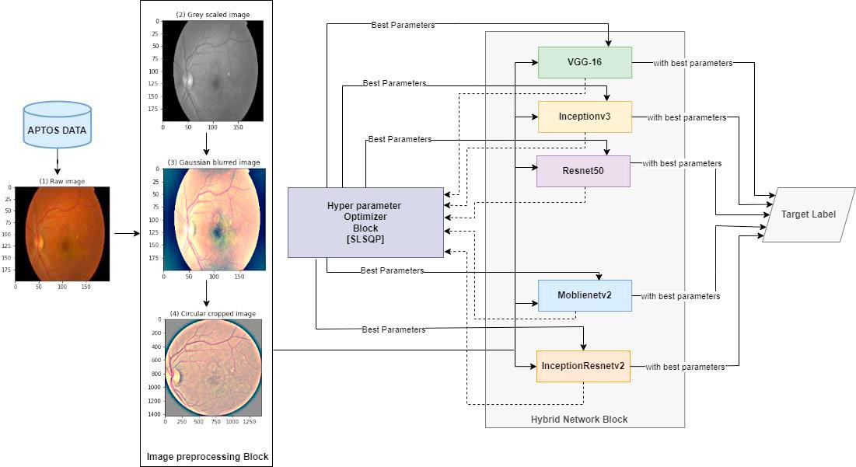
Base Model(Cont.)
Fig 10. Schematic Diagram of Diabetic Retinopathy Grading From Color Fundus Images: An Autotuned Deep Learning Approach [8]

Slide 29
Base Model(Cont.)
Table-2: Table for Base Models
BASE MODEL 01 | BASE MODEL 02
CLAHE, Gaussian Filter and Data Augmentation Pre-trained Models are used for feature extraction | Gray Scale, Gaussian Filter and Circular Crop for preprocessing Hyper Parameter Optimizer Block for best parameter selection
SVM is used as classifier | comparative analysis of pre-trained models
Accuracy : 96.96% | Accuracy : 94.7%

Slide 30
Results
Table-3: Table for result from pretrained models
Model name | Accuracy | Precision | Recall | F1-score
Xception | 73.54% | 0.7541 | 0.7354 | 0.7390
Dense Net 121 | 73.33% | 0.7547 | 0.7333 | 0.7413
Inception V3 | 73.13% | 0.7301 | 0.7313 | 0.7303
Efficient B3 | 73.13% | 0.7473 | 0.7313 | 0.7362
Mobile Net V3 | 72.12% | 0.7282 | 0.7212 | 0.7212
VGG 19 | 59.39 | 0.5978 | 0.5939 | 0.5866
VGG 16 | 61.82 | 0.6562 | 0.6182 | 0.6308
Resnet 101 | 70.91 | 0.7193 | 0.7091 | 0.7130
Mobile Net V2 | 71.11 | 0.7268 | 0.7111 | 0.7164
Dense Net 201 | 71.92 | 0.7352 | 0.7192 | 0.7246

Slide 31
Results(Cont.)
Table-4: Result from Xception_ResNet101 model (Accuracy: 73.74%)
Serial No. | Class Name in Dataset | F1 Score | Precision | Recall
01. | Glaucoma | 0.8765 | 0.9803 | 0.8765
02. | Myopia | 0.6587 | 0.6385 | 0.6587
03. | Macular Scar | 0.6034 | 0.7292 | 0.6034
04. | Healthy | 0.4324 | 0.4211 | 0.4324
05. | Diabetic Retinopathy | 0.7885 | 0.6457 | 0.7885

Slide 32
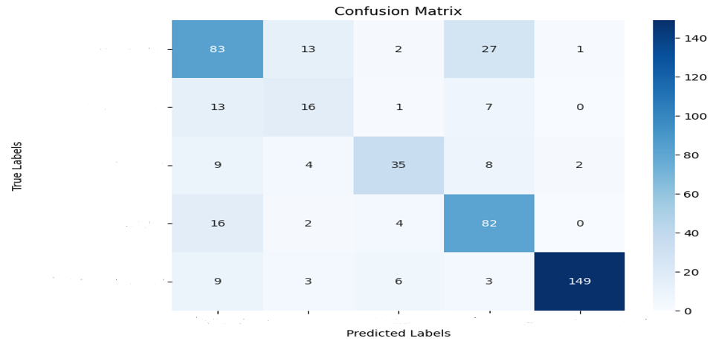
Results(Cont.)
Glaucoma
Myopia
Macular Scar
Healthy
Diabetic Retinopathy
Glaucoma
Myopia
Macular Scar
Healthy
Diabetic Retinopathy
Fig11: Confusion Matrix of Xception_ResNet101 model

Slide 33
Remaining Experiments
Advanced Ensemble Techniques:
Analyze the strengths and weaknesses of pre-trained models.
Combine high-performing models (e.g., Xception, EfficientNet, Densenet) strategically to complement strengths and minimize weaknesses.
Explore feature-sharing strategies across ensemble layers for enhanced performance.

Slide 34
Remaining Experiments (cont’d)
Cross-Validation for Robustness:
Implement five-fold cross-validation.
Ensure balanced class representation across folds.
Visualize outcomes using confusion matrices and performance graphs.

Slide 35
Remaining Experiments (cont’d)
Validation on Baseline Paper's Dataset:
Test the ensemble model against datasets used in baseline studies.
Compare performance on key metrics to validate improvements.
Identify where the ensemble outperforms and areas needing enhancement.

Slide 36
Conclusion
Techniques such as CLAHE, Gaussian filtering, unsharp masking, and data augmentation are employed to reduce noise and enhance image quality.
Various pre-trained models have been tested to optimize performance.
Ensemble approach, combining two pre-trained models, has been utilized to further improve accuracy.
Despite these efforts, the results remain suboptimal, and ongoing experiments aim to enhance model performance.

Slide 37
References
https://www.kaggle.com/code/blurredmachine/vggnet-16-architecture-a-complete-guide
https://www.researchgate.net/publication/364258752_A_VGG-19_Model_with_Transfer_Learning_and_Image_Segmentation_for_Classification_of_Tomato_Leaf_Disease/figures?lo=1
https://medium.com/@siddheshb008/vgg-net-architecture-explained-71179310050f
https://pytorch.org/blog/torchvision-mobilenet-v3-implementation/
https://machinethink.net/blog/mobilenet-v2/
https://medium.com/@AnasBrital98/inception-v3-cnn-architecture-explained-691cfb7bba08
A dataset of color fundus images for the detection and classification of eye diseases - ScienceDirectSTARE Dataset | Kaggle
Diabetic Retinopathy Grading From Color Fundus Images: An Autotuned Deep Learning Approach
Deep Neural Network-Based Ensemble Model for Eye Diseases Detection and Classification

Slide 38
Thank You!

